Slide 1
Scheduling and Tracking
SE423: Software Project Management

Slide 2
Outline
Schedule Development
Work Breakdown Structure (WBS)
Network Analysis
Scheduling Workflow
PERT Estimation Technique
Project Tracking

Slide 3
Schedule Development

Slide 4
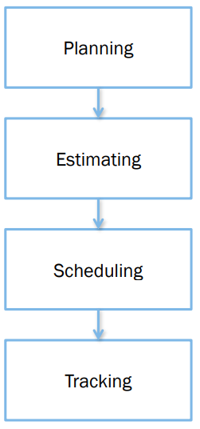
Planning, Estimation, Scheduling, Tracking
Plan: Identify activities. No specific start and end dates.
Estimating: Determining the size & duration of activities.
Schedule: Adds specific start and end dates, relationships, and resources.
Track: Uses monitoring and tools to determine if plans, estimates, and schedules are accurate

Slide 5
How to Schedule?
Identify “what” needs to be done
Work Breakdown Structure (WBS)
Identify “how much” (the size)
Size estimation techniques
Identify the dependency between tasks
Dependency graph, network diagram
Estimate total duration of the work to be done
The actual schedule

Slide 6
Partitioning Your Project
You need to decompose your project into manageable chunks
ALL projects need this step
Divide & Conquer
Two main causes of project failure
Forgetting something critical
Ballpark estimates become targets
How does partitioning help this?

Slide 7
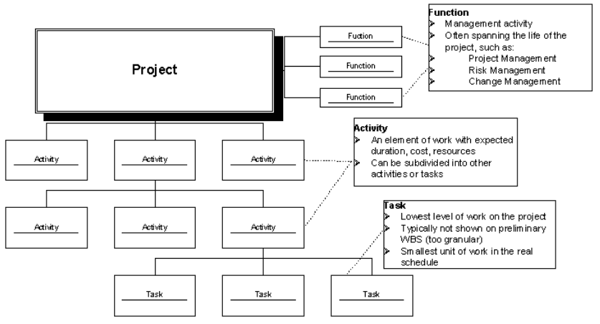
Project Elements
A Project: functions, activities, tasks

Slide 8
Definition
Schedule development is the culmination of the other Project Time Management processes we have discussed:
Activity definition
Activity sequencing
Activity resource estimating
Activity duration estimating
It is an iterative process to determine planned start and finish dates for activities
It is a continuous process throughout project, addressing approved changes and risks

Slide 9
Controlling factors in schedule development
Project scope statement
Scope statement is the source of assumptions and constraints on the project
(PMI) “Assumptions are those documented, schedule-related factors that, for schedule development purposes, are considered to be true, real, or certain.”
(PMI) “Constraints are factors that will limit the project management team's options when performing schedule network analysis.”
Date constraints (contract dates, market windows, external deliveries) and milestones (deliverable dates) are of greatest importance in schedule development

Slide 10
Controlling factors in schedule development
Project management plan
Almost any of the many sub-plans and other elements in the Project Management Plan may exert an influence on schedule development
One of the most critical elements for schedule development in the PM Plan is the risk register and risk-associated plans
We will discuss risk and risk-related planning in an upcoming lecture

Slide 11
Work Breakdown Structure (WBS)

Slide 12
Work Breakdown Structure (WBS)
Work Break Down Structure (WBS)
a check list of the work that must be accomplished to meet the project objectives.
The WBS lists the major project outputs and those departments or individuals primarily responsible for their completion.

Slide 13
WBS Outline Example
0.0 Retail Web Site
1.0 Project Management
2.0 Requirements Gathering
3.0 Analysis & Design
4.0 Site Software Development
4.1 HTML Design and Creation
4.2 Backend Software
4.2.1 Database Implementation
4.2.2 Middleware Development
4.2.3 Security Subsystems
4.2.4 Catalog Engine
4.2.5 Transaction Processing
4.3 Graphics and Interface
4.4 Content Creation
5.0 Testing and Production

Slide 14
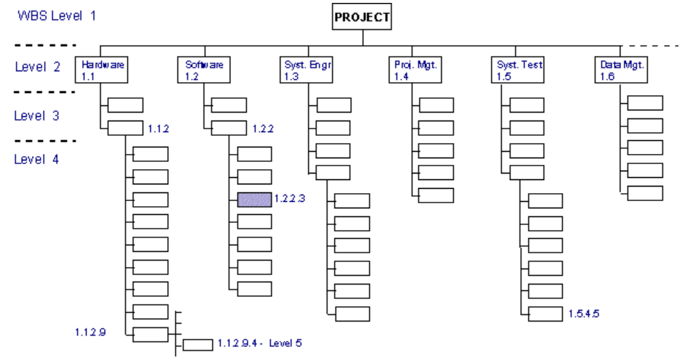
WBS Format for System Development Projects

Slide 15
WBS Types
Process WBS
a.k.a Activity-oriented
Ex: Requirements, Analysis, Design, Testing
Typically used by PM
Product WBS
a.k.a. Entity-oriented
Ex: Financial engine, Interface system, DB
Typically used by engineering manager
Hybrid WBS: both above
This is not unusual
Ex: Lifecycle phases at high level with component or featurespecifics within phases
Rationale: processes produce products

Slide 16
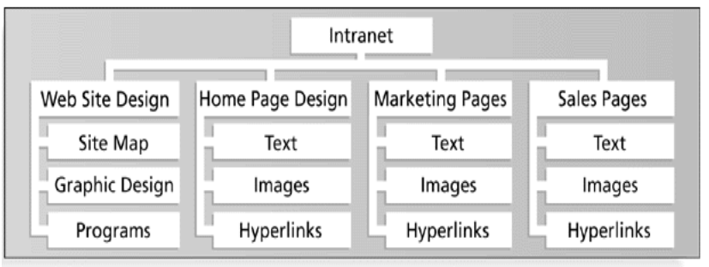
Product WBS

Slide 17
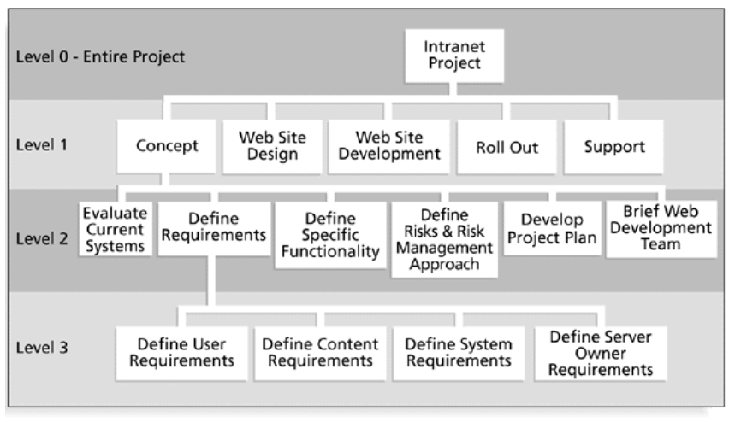
Process WBS

Slide 18
Process WBS
List of Activities, not Things
List of items can come from many sources
SOW, Proposal, brainstorming, stakeholders, team
Describe activities using “bullet language”
Meaningful but terse labels
All WBS paths do not have to go to the same level
Do not plan more detail than you can manage

Slide 19
Work Packages (Tasks)
Generic term for discrete tasks with definable end results
The “one-to-two” rule
Often at: 1 or 2 persons for 1 or 2 weeks
Basis for monitoring and reporting progress
Can be tied to budget items (charge numbers)
Resources (personnel) assigned
Ideally shorter rather than longer
Longer makes in-progress estimates needed
These are more subjective than “done”
“4/40” or “8/80” rule ( shortest/longest duration)
Not so small as to micro-manage

Slide 20
WBS and Methodology
PM must map activities to chosen lifecycle
Each lifecycle has different sets of activities
Integral process activities occur for all
Planning, configuration, testing
Operations and maintenance phases are not normally in plan (considered post-project)
Some models are “straightened” for WBS
Spiral and other iterative models
Linear sequence several times
Deliverables of tasks vary by methodology

Slide 21
WBS Techniques
Top-Down
Bottom-Up
Analogy
Rolling Wave
1st pass: go 1-3 levels deep
Gather more requirements or data
Add more detail later
Post-its on a wall
All WBS Techniques rely upon Expert Judgment!

Slide 22
WBS Techniques
Top-down
Start at highest level
Systematically develop increasing level of detail
Best if
The problem is well understood
Technology and methodology are not new
This is similar to an earlier project or problem
But is also applied in majority of situations

Slide 23
WBS Techniques
Bottom-up
Start at lowest level tasks
Aggregate into summaries and higher levels
Cons
Time consuming
Needs more requirements complete
Pros
Detailed

Slide 24
WBS Techniques
Analogy
Base WBS upon that of a “similar” project
Use a template
Analogy also can be estimation basis
Pros
Based on past actual experience
Cons
Needs comparable project

Slide 25
WBS Techniques
Brainstorming
Generate all activities you can think of that need to be done
Group them into categories
Both Top-down and Brainstorming can be used on the same WBS
Remember to get the people who will be doing the work involved (buy-in matters!)

Slide 26
WBS basis for many things
Network scheduling
Costing
Risk analysis
Organizational structure
Control
Measurement

Slide 27
WBS Guidelines
Should be easy to understand
Some companies have corporate standards for these schemes
Some top-level items, like Project Mgmt. are in WBS for each project
Others vary by project
What often hurts most is what’s missing
Break down until you can generate accurate time & cost estimates
Ensure each element corresponds to a deliverable

Slide 28
Network Analysis

Slide 29
Network Analysis
Network analysis is the technique that generates the project schedule
Network analysis may use several different analysis methods to calculate the early and late start dates for project activities. These methods may be combined and include:
Gantt Charts
Critical Path Method (CPM)
Critical Chain Method (CCM)
What-if analysis
Resource leveling

Slide 30
Network Analysis
There are a number of network analysis techniques available – we will concentrate on the Critical Path Method (CPM)
We have already seen a significant component of another network analysis technique, the PERT estimates for activity duration
The Precedence Diagram Method (PDM) is a graphical network technique that establishes activity sequencing
Network analysis may also make use of mandatory or discretionary parallelism in project activities to allow schedule compression

Slide 31
Network Analysis Terminology
Activity. An activity always consumes time and may also consume resources. I use task and activity equivalently
Critical. A critical activity or event is one that must be achieved by a certain time, having no latitude (slack or float)
Critical path. The critical path is the longest path through a project network. Because it has no slack, all activities on the critical path must be completed as scheduled, or the end date will slip
Events. Beginning and ending points of activities are known as events. An event is a specific point in time
Milestone. An event representing a point in a project of special significance. Usually the completion of a major phase of the work. Project reviews are often conducted at milestones

Slide 32
Creating a precedence table
A Precedence table documents task durations and interdependencies
Estimating duration of each task
Duration estimated from historical information:
Ideally, based on organization's historical experience, if available
More likely: ‘expert’ knowledge
Estimation done by task leaders or functional managers
Any potentially risky task (technology, skills, dependencies) should include contingency factor
Include contingencies to mitigate potential resource shortages

Slide 33
Creating a precedence table
Determining task interdependencies
Goal is to determine predecessor/successor relations
Understanding interdependencies allows proper ordering in scheduling tasks
Understanding interdependencies also helps in finding possible parallel tasks, which can shorten schedule
Parallel tasks should be truly independent to minimize risk of backtracking
Determining task interdependencies must be a team effort to avoid unpleasant surprises

Slide 34
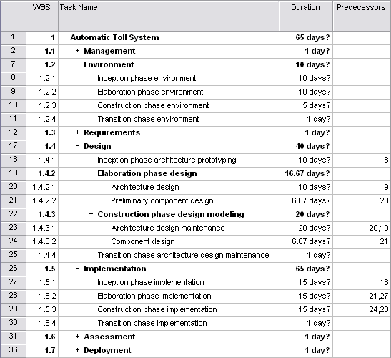
Sample evolutionary precedence table

Slide 35
Network Techniques
A precedence network diagram is a graphic model portraying the sequential relationship between key events in a project.
Initial development of the network requires that the project be defined and thought out.
The network diagram clearly and precisely communicates the plan of action to the project team and the client.

Slide 36
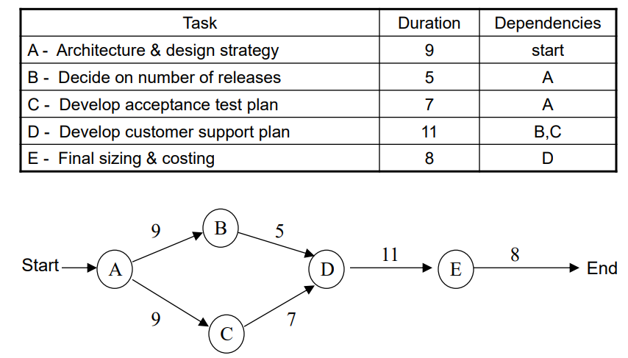
Precedence Network Diagram

Slide 37
What is a PERT?
Program Evaluation & Review Technique or PERT
Identify the tasks (or activities) required to complete the given project
Use the WBS
List the activities in a structured fashion, along with their interdependencies
Use a Gantt Chart
Precedence table
A "network" of the activities and their dependencies is drawn up. In MS Project, PERT is called Network Diagram
Each event may be represented by a node
Before any activity can begin, all its predecessor activities must have been completed
Notes:
PERT - short for Program Evaluation & Review Technique - is an outgrowth of research work carried out by the U.S. navy in the late 1950s, when they were trying to put the Polaris Fleet Ballistic Missile Project on schedule. There were thousands of contractors and agencies involved in this project. Earlier askance at this technique gave way to respect when the program ended two years before its scheduled completion date.

Slide 38
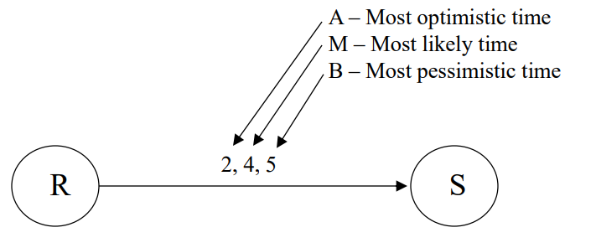
PERT
Expected Time = (a + 4m + b)/6
Expected Time = 3.8

Slide 39
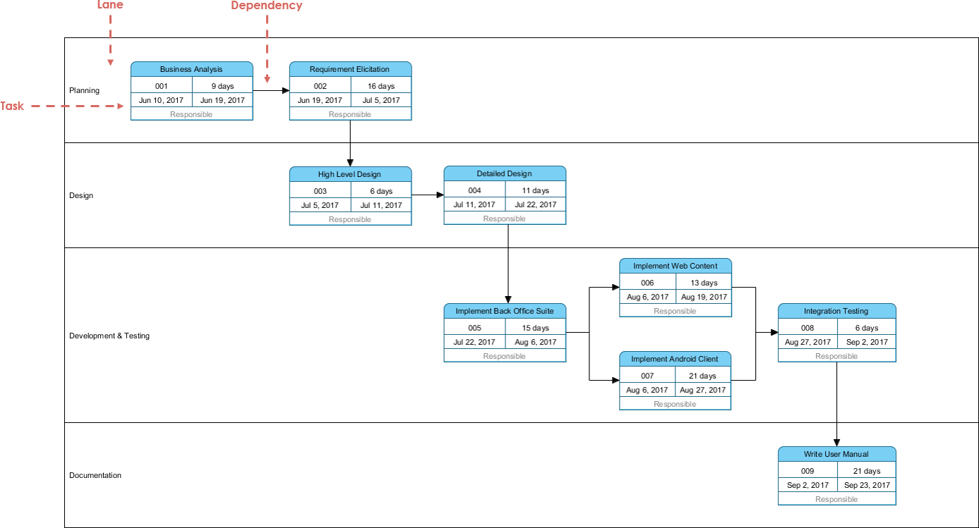
PERT Chart

Slide 40
Slack Time
Slack time, also known as float, is the amount of delay expressed in units of time that could be tolerated in the starting time or completion time of an activity without causing a delay in the completion of the project.
Slack time is the difference between the late finish and the early finish (LF-EF). If the result is greater than zero, then the activity has a range of time in which it can start and finish without delaying the project completion date, as shown in the figure below:
A
Duration
Slack
ES
EF
LF

Slide 41
Slack Time
If an activity has zero slack, it determines the project completion date. In other words, all the activities on the critical path must be done on their earliest schedule or the project completion date will suffer.
If an activity with total slack greater than zero were to be delayed beyond its late finish date, it would become a critical path activity and cause the completion date to be delayed.
The sequence of activities that has zero slack is defined as the critical path
In general, the critical path is the path that has minimum slack.

Slide 42
Critical Path Method
The critical path method (CPM) focuses on calculating theoretical start and finish dates for every activity in the project. In the context of the CPM, the following definitions are essential:
Critical. A critical activity or event is one that must be achieved by a certain time; a critical activity has no latitude (slack or float)
Critical path. The critical path is the longest path through a project network. Because it has no slack, all activities on the critical path must be completed as scheduled, or the end date will slip

Slide 43
Critical Path Method
CPM performs these calculation without regard for resource limitations, which can lead to resource over-allocation or inefficient multitasking
A forward pass analysis performs schedule calculations that identify the early start and ﬁnish dates of activities and the project
A backward pass analysis performs schedule calculations that identify the late start and ﬁnish dates of activities and the project, as well as total and free ﬂoat
Total ﬂoat (TF) is the amount of time an activity can be delayed without delaying the project as a whole
Free ﬂoat (FF) is the amount of time an activity can be delayed without delaying its successor (dependent) activities
Note that total ﬂoat is global to the project, while free ﬂoat is local to the neighborhood of the activity

Slide 44
Critical Path Method
Critical Path Method (CPM) tries to answer the following questions:
What is the duration of the project?
By how much (if at all) will the project be delayed if any one of the activities takes N days longer?
How long can certain activities be postponed without increasing the total project duration?

Slide 45
Critical Path Method
Sequence of activities that have to be executed one after another
Duration times of these activities will determine the overall project time, because there is no slack/float time for these activities
If any of the activities on the critical path takes longer than projected, the entire project will be delayed by that same amount
Critical path = Longest path in the precedence network (generally, the longest in time)

Slide 46
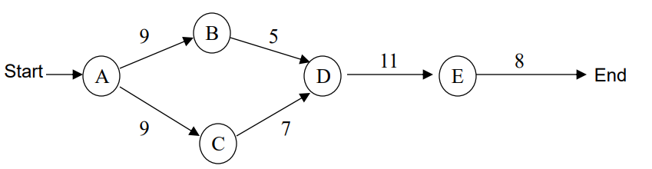
Critical Path Example
Critical Path = A – C – D – E (35 time units)
Critical Tasks = A,C,D,E
Non-Critical Path = A-B-D-E
Non-Critical Tasks = B (only)

Slide 47
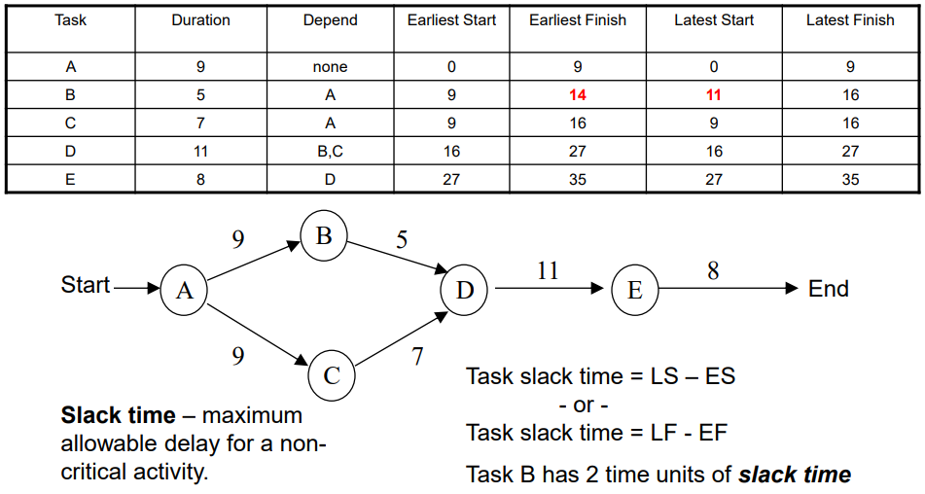
Critical Path Example

Slide 48
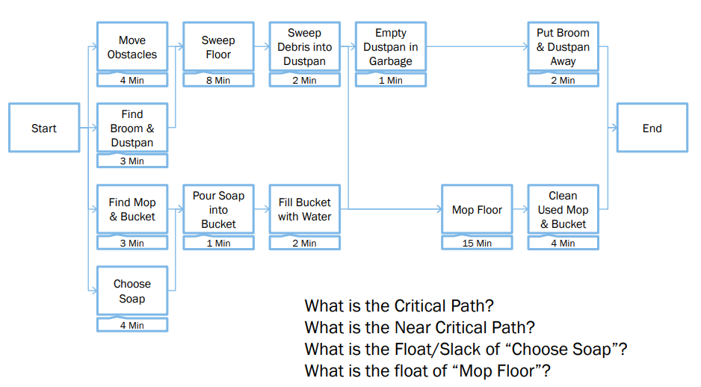
Critical Path Example

Slide 49
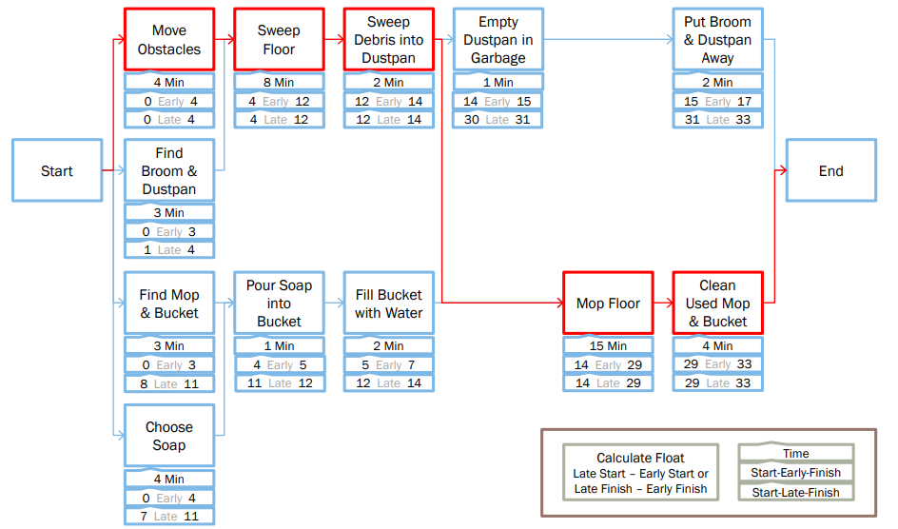
Critical Path

Slide 50
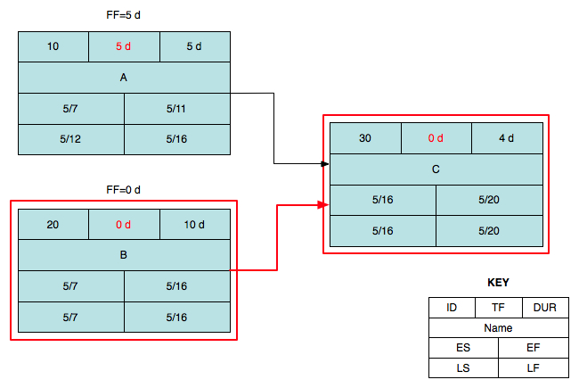
Simple critical path example
Critical Path

Slide 51
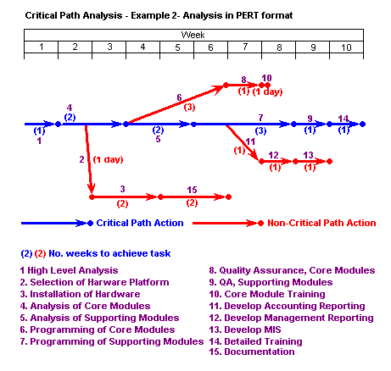
Carrying out the example critical path analysis above shows us:
That if all goes well the project can be completed in 10 weeks
That if we want to complete the task as rapidly as possible, we need:
1 analyst for the first 5 weeks
1 programmer for 6 weeks starting week 4
1 programmer for 3 weeks starting week 6
Quality assurance for weeks 7 and 9
Hardware to be installed by the end of week 7
That the critical path is the path for development and installation of supporting modules
That hardware installation is a low priority task as long as it is completed by the end of week 7

Slide 52
Performing forward pass CP analysis
ES = Maximum EF of predecessor task(s)
EF = ES + duration of task
10
TF
5 days
A
2
5/7
5/11
30
TF
4 days
1
C
5/16
5/19
4
1
20
TF
10 days
B
5/7
5/16
2
3
Key
ID
TF
DUR
Name
ES
EF
LS
LF

Slide 53
Performing backward pass CP analysis
LF = Minimum LS of successor task(s)
LS = LF – duration of task
10
TF
5 days
A
3
5/7
5/11
30
TF
4 days
5/12
5/16
C
4
5/16
5/19
4
20
TF
10 days
5/16
5/19
1
B
5/7
5/16
Key
3
2
ID
TF
DUR
5/7
5/16
Name
ES
EF
LS
LF

Slide 54
Calculating float
FF = 6
TF = LF - EF
FF = Minimum ES (successor task) – EF
10
6 days
5 days
A
5/7
5/11
30
0 days
4 days
Critical path
5/12
5/16
C
5/16
5/19
20
0 days
10 days
5/16
5/19
B
5/7
5/16
Key
5/7
5/16
ID
TF
DUR
Name
ES
EF
FF = 0
LS
LF

Slide 55
What is a Gantt chart?
A Gantt Chart (named for Henry Laurence Gantt) consists of a table of project task information and a bar chart that graphically displays project schedule, depicting progress in relation to time and often used in planning and tracking a project.
Horizontal bar chart format, with bars representing the phases and activities of the WBS
Time extends along the horizontal axis
Able to show planned and actual progress on tasks as well as task dependencies
Effective communication tool but with limitations
Very low information density: lots of wasted space
Not very useful for large projects
Notes:
Henry Gantt (1861-1919), a mechanical engineer, management consultant, and industrial advisor developed Gantt charts in the 1910's. Not as commonplace as they are today, Gantt charts were innovative and new during the 1920's, where Gantt charts were used on large construction projects like the Hoover Dam started in 1931 and the Eisenhower National Defense Interstate Highway System started in 1956.

Slide 56
Gantt Chart
Gantt chart is a means of displaying simple activities or events plotted against time or dollars
Most commonly used for exhibiting program progress or for defining specific work required to reach an objective
Gantt charts may include listing of activities, activity duration, scheduled dates, and progress-to-date

Slide 57
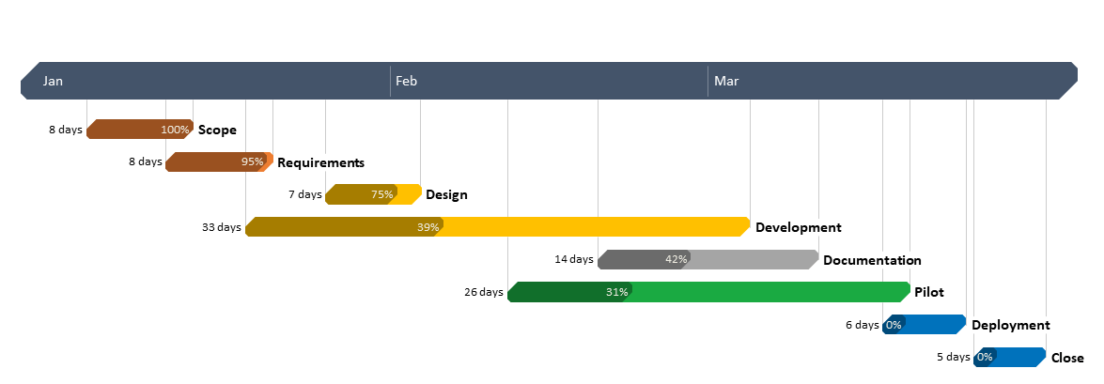
Gantt Chart

Slide 58
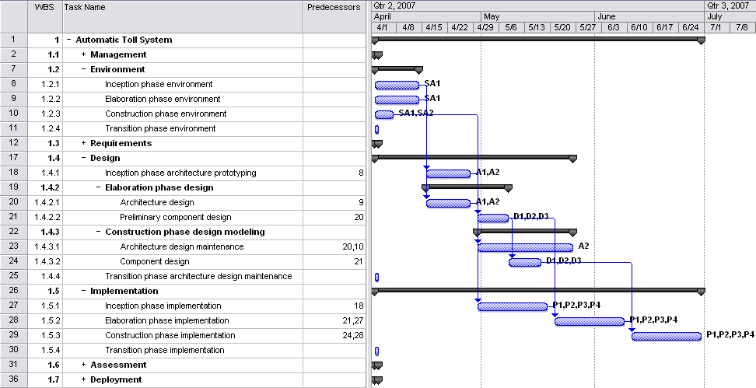
Sample evolutionary Gantt chart

Slide 59
Gantt Chart
Advantages:
Easy to understand
Easy to change
Disadvantages:
Only a vague description of the project
Does not always show interdependency of activities
May not show results of an early or late start of an activity

Slide 60
Gantt Example
Suppose a project comprises five activities: A,B,C,D, and E. A and B have no preceding activities, but activity C requires that activity B must be completed before it can begin. Activity D cannot start until both activities A and B are complete. Activity E requires activities A and C to be completed before it can start. If the activity times are A: 9 days; B: 3 days; C: 9 days; D: 5 days; and E: 4 days, determine the shortest time necessary to complete this project.
Identify those activities which are critical in terms of completing the project in the shortest possible time. [Critical path ]
 | 1 | 2 | 3 | 4 | 5 | 6 | 7 | 8 | 9 | 10 | 11 | 12 | 13 | 14 | 15 | 16 | 17 | 18
A
B
C
D
E
Time is 16 days
Critical path is B, C, E

Slide 61
Critical Chain Method
The critical chain method (CCM) is a project management technique that is used to improve the accuracy of project planning and scheduling.
In software engineering projects, CCM can be used to identify and manage critical tasks, reduce project risk, and improve project delivery time.
CCM focuses on the resources required for project activities, attempting to keep them leveled throughout the project
CPM scheduling is rigid and brittle: most activities have little or no ﬂoat, while the critical path, by deﬁnition, has no ﬂoat whatsoever— any delay in a critical path activity leads to a project delay

Slide 62
Critical Chain Method
CCM, by contrast, assumes that all activities have a statistically-probable range of durations and uses this assumption to create a more ﬂexible and resilient schedule
Each activity is assigned two durations: a ‘most likely’ or ‘best guess’ duration and a ‘pessimistic’ or ‘safe’ duration
The most likely duration represents the time it would take to complete the activity 50% of the time;
half of the time it would take less time, half of the time it would take more time
The pessimistic duration represents the time it would take to complete the activity 90% of the time;
90% of the time it would take less time, only 10% of the time it would take more time
Resources are assigned to the activities using the most likely durations
The longest sequence of activities in the project is called the critical chain

Slide 63
Critical Chain Method
Suppose a software development team is tasked with developing a new mobile application.
The project timeline is six months, and the team must deliver a functional prototype at the end of the fourth month.
To manage the project using CCM, the following steps could be taken:
Identify the critical tasks: The team would begin by identifying the critical tasks that must be completed to deliver the functional prototype on time. These tasks might include developing the user interface, integrating with external APIs, and testing the application.

Slide 64
Critical Chain Method
Estimate task duration: Once the critical tasks have been identified, the team would estimate the duration of each task, taking into account any potential delays or obstacles that might arise during the development process.
Create a buffer: To account for potential delays and risks, the team would create a buffer at the end of the project timeline. This buffer would be used to ensure that the functional prototype is delivered on time, even if some tasks take longer than expected.
Manage the critical chain: Using CCM, the team would manage the critical chain of tasks by focusing on the critical tasks and ensuring that they are completed on time. This might involve reallocating resources, adjusting task priorities, or providing additional support to team members as needed.
Monitor progress: Throughout the project, the team would monitor progress and adjust the project plan as needed. This would help to ensure that the project stays on track and that the critical tasks are completed on time.

Slide 65
Critical Chain Method
Using CCM could reduce project risk, improve project delivery time, and ensure that the functional prototype is delivered on time.
Buffer Types:
Project buffer
A reserve inserted at end of the project. Any delay in the Longest Path will consume some or all of the buffer, and the completion date will not change.
Feeding buffers
A reserve inserted before the first activity on the Critical Chain. This is to ensure that any tasks feeding into the Critical Chain may not delay the Critical Chain.
Resource buffers
Activities with critical resource assignment, added at one or more places on the Critical Chain with so as to ensure that the resource is available and committed to be utilized if needed.

Slide 66
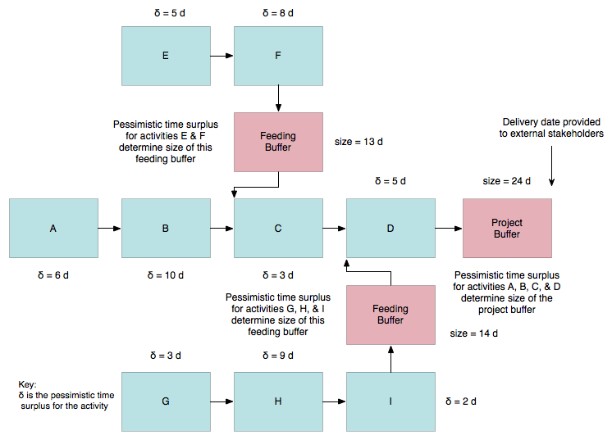
Critical Chain Method

Slide 67
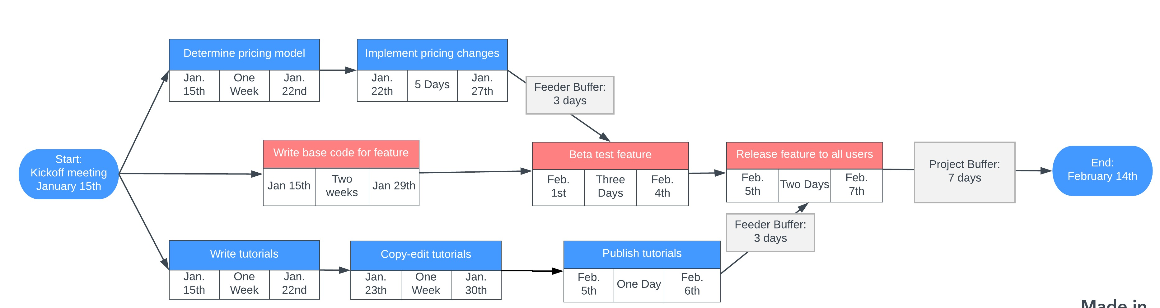
Critical Chain Method

Slide 68
What-if analysis
Scenario-based analysis of schedule to determine effects of various scenarios on different aspects of the project
Example: Delay delivery of a critical component by various amounts to determine effect on schedule
Example: COTS supplier is unable to provide a critical component at all
What-if scenario analysis effectively tests the robustness of the project schedule in response to adverse circumstances
Most common technique uses Monte Carlo analysis to generate a population of possible project schedule outcomes
Think of executing the same project 10,000 times with the same resources, different boundary conditions, and no memory between executions
Very useful in preparing contingency and response plans for project risks

Slide 69
Resource leveling
Resource leveling is applied to a schedule analyzed by CPM
Addresses situation where resource availability is constrained by time or amount of the resource available
May also be used to keep resource usage at a constant level during certain time periods in the project
Resource leveling is needed when resources have been over-allocated or assigned to two or more activities in the same time period
May change the critical path in the schedule model
Beware of automated resource leveling—the project schedule network may be nearly unrecognizable after leveling

Slide 70
Resource leveling
Uses a number of different approaches, including:
Assign under-allocated resources to multiple tasks to keep them busy
Move key resources off of non-critical tasks
Delay start of task until required resources are available, possibly using lags
Split tasks into two or more subtasks so the subtasks can be assigned to different resources

Slide 71
Applying leads and lags
Applying leads and lags allows refinement of a schedule once the major schedule network analysis effort has been completed
Use of leads and lags may be used to meet imposed constraints, help in resource leveling, or incorporate contingency reserves into a schedule

Slide 72
Calendars
Identify days and dates when work can be performed
Affect all project-related activities
General project calendars govern overall limitations on when project work may be performed
Example: Work is performed at a client site, and the client shuts down for three weeks during the summer
Resource calendars govern limitations on when particular resources (or resource groups) may perform project work
Example: Individual project team member vacation schedules
Example: Development team training schedules

Slide 73
Schedule development output
Project schedule network diagrams
Show both project network logic (sequencing) as well as critical path schedule activities
Usually displayed as an activity-on-node diagram
Gantt charts
Specialized bar charts format to show activity start and end dates, along with durations
Easy to read but limited by low information density
Milestone charts
‘Stripped-down’ version of Gantt chart, showing only milestones

Slide 74
Reducing Project Duration
How can you shorten the schedule?
Via
Reducing scope (or quality)
Adding resources
Concurrency (perform tasks in parallel)
Substitution of activities

Slide 75
Schedule compression
Shortens the project schedule without changing the project scope, to meet schedule constraints, imposed dates, or other schedule objectives
There are two types of schedule compression, crashing and fast-tracking
Crashing. Analyzes cost and schedule trade-offs to get the greatest amount of compression with the least cost
Examples: Use of additional resources, being more efficient, changing approach used to perform work, work overtime
Schedule crashing only works for activities where additional resources may shorten the duration of the activity

Slide 76
Schedule compression
Fast-tracking. Activities that would normally be done sequentially are done in parallel.
Fast-tracking can lead to rework and increased risks due to unforeseen dependencies
Fast-tracking only works when activities can be overlapped to shorten the total duration

Slide 77
Compression Techniques
Shorten the overall duration of the project
Crashing
Looks at cost and schedule tradeoffs
Gain greatest compression with least cost
Add resources to critical path tasks
Limit or reduce requirements (scope)
Changing the sequence of tasks
Fast Tracking
Overlapping of phases, activities or tasks that would otherwise be sequential
Involves some risk
May cause rework
Barry Boehm says you cannot compress more than 25%

Slide 78
Task
Name
ID
Description of work
Duration (days)
Start Date (Earliest, Latest)
Finish Date (Earliest, Latest)
Resources (People and equipment)
Effort (In staff-days)
Predecessors (other tasks)
Inputs (documents, decisions, information)
Successors (other tasks)
Outputs (documents, decisions, information)

Slide 79
Mythical Man-Month
Book: “The Mythical Man-Month”
Author: Fred Brooks
“The classic book on the human elements of software engineering”
First two chapters are full of terrific insight (and quotes)
Sample Quotes
“Cost varies as product of men and months, progress does not.”
“Hence the man-month as a unit for measuring the size of job is a dangerous and deceptive myth”
Notes:
Software is a ‘systems effort’

Slide 80
Mythical Man-Month
Why is software project disaster so common?
Estimation techniques are poor & assume things will go well (an ‘unvoiced’ assumption)
Estimation techniques fallaciously confuse effort with progress, hiding the assumption that men and months are interchangeable
Because of estimation uncertainty, manager lack courteous stubbornness
Schedule progress is poorly monitored
When schedule slippage is recognized, the natural response is to add manpower. Which, is like dousing a fire with gasoline.

Slide 81
Mythical Man-Month
Optimism
“All programmers are optimists”
1st false assumption: “all will go well” or “each task takes only as long as it ‘ought’ to take”
The Fix: Consider the larger probabilities
Cost (overhead) of communication (and training)
His formula: n(n-1)/2
How long does a 12 month project take?
1 person: 12 months
2 persons = 7 months (2 man-months extra)
3 persons = 5 months (3 man-months extra)
Fix: don't assume adding people will solve the problem

Slide 82
Mythical Man-Month
Sequential nature of the process
“The bearing of a child takes nine months, no matter how many women are assigned”
What is the most mis-scheduled part of process?
Testing (the most linear process)
Why is this particularly bad?
Occurs late in process and w/o warning
Higher costs: primary and secondary
Fix: Allocate more test time
Understand task dependencies
Notes:
He advocates 50% of schedule to Test
Late
Highest cost: most staffed time
Changes cost more
Secondary costs
You need to understand Critical Path and other dependencies

Slide 83
Mythical Man-Month
Reliance on hunches and guesses
What is ‘gutless estimating’?
The myth of additional manpower
Brooks Law: “Adding manpower to a late project makes it later”
Q: “How does a project get to be a year late”?
A: “One day at a time”
Studies
Each task: twice as long as estimated
Only 50% of work week was programming
Fixes
No “fuzzy” milestones (get the “true” status)
Reduce the role of conflict
Identify the “true status”
Notes:
omelet and chef analogy
what does Brooks mean by this?
Termites not tornadoes
Imperceptibly but inexorably
Hard to recognize
Reduce conflict: status vs. action meetings

Slide 84
Scheduling Workflow

Slide 85
Scheduling Workflow
Define activities
Use of WBS template helps guide definition process and organize activities
Perform activity sequencing
Develop schedule framework according to what is logically possible – perform resource allocation later
Estimate effort – the total number of labor units (e.g. staff-days) for each activity
Identify resources for each activity
Apply calendars to schedule framework

Slide 86
Scheduling Workflow
Estimate activity duration based on resources for activity
Perform forward pass or backward pass critical path analysis to generate schedule model
Perform ‘what-if’ scenario analysis to identify contingency and risk response needs
Apply resource leveling to schedule model
Apply schedule compression, if needed

Slide 87
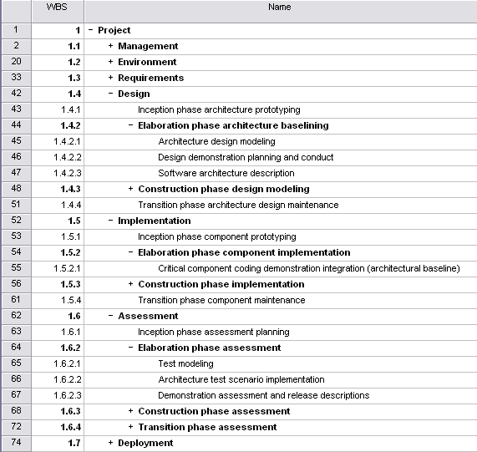
WBS template
Component groups with a ‘+’ in front of them are ‘rolled up’ – subcomponents are hidden to reduce clutter

Slide 88
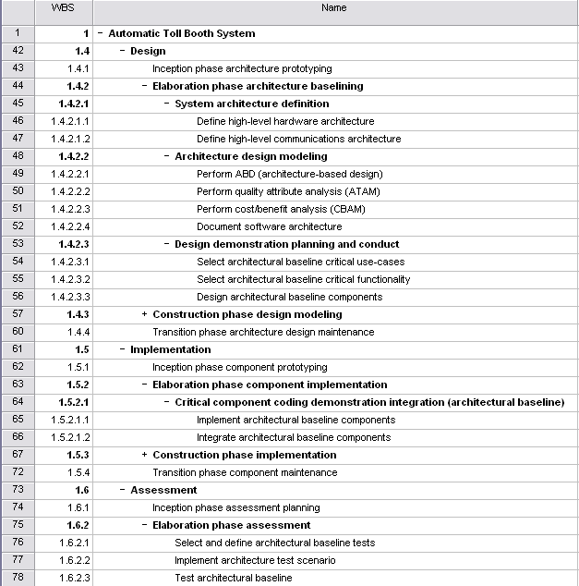
Activity definition
Added System architecture definition WBS component
Note expansion and detailing of WBS template Architecture design modeling entry; renamed Software architecture description to Document software architecture
Note expansion and detailing of WBS template Design demonstration planning and conduct entry
Note rework of WBS template Elaboration phase assessment entry
Note expansion and detailing of WBS template Critical component coding demo integration entry

Slide 89
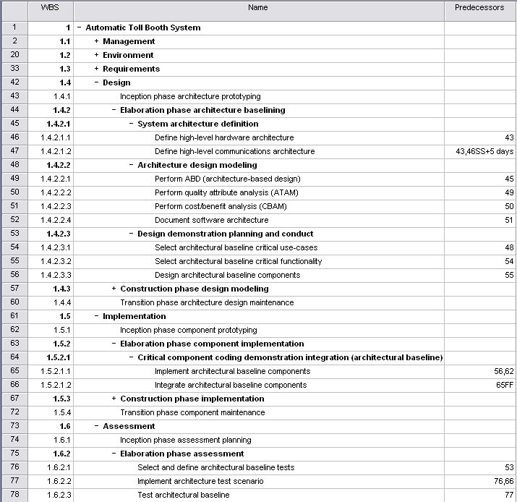
Activity sequencing
Note dual predecessors.
Default relationship is Finish-to-Start. Here, we have defined a Start-to-Start relationship with an added lag of 5 days
Here, we have defined a Finish-to-Finish relationship: this is common for implementation/integration task pairs

Slide 90
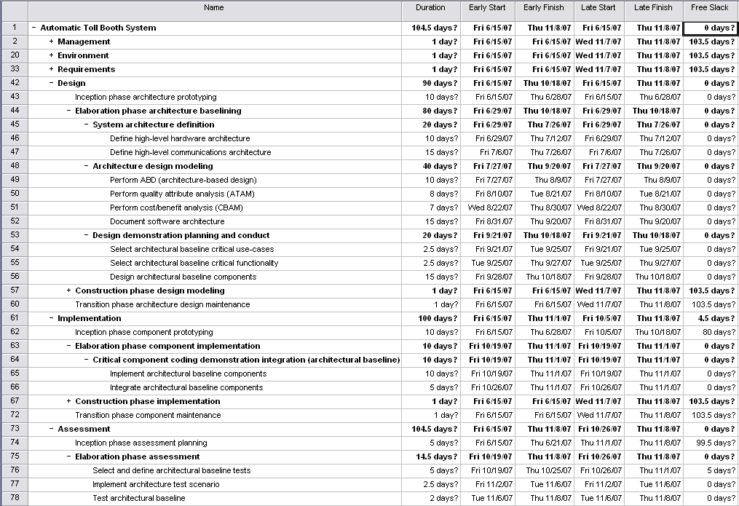
Critical path: early/late start and finish with float (slack)

Slide 91
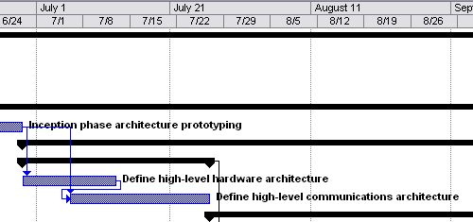
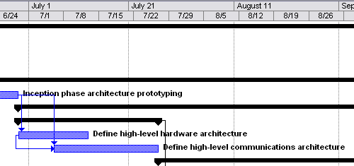
Schedule Compression
Use Finish-to-Start dependency with 5 day negative lag (-5) for successor to get reasonable relationship between two tasks. Equivalent to a 5 day lead for successor
Alternatively:
Use Start-to-Start dependency with 5 day lag for successor to get reasonable relationship between two tasks
Note schedule compression of 5 days

Slide 92
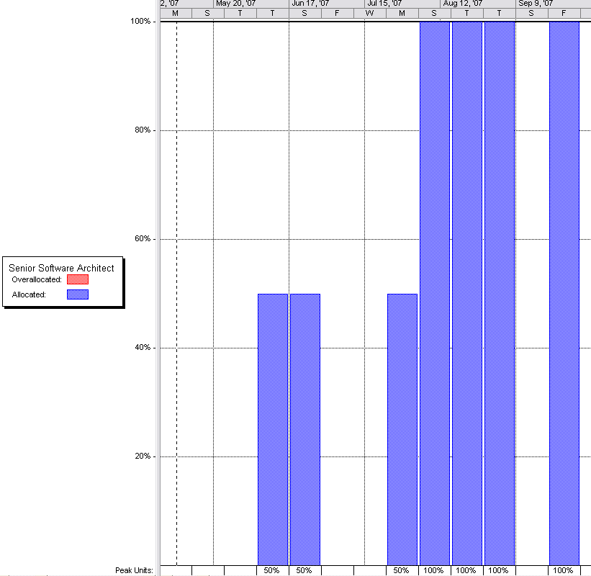
Determining resource utilization
Resource graphs show the utilization of individual resources as a function of time
Resource graphs can be used to identify over- and under-utilized resources
Resource leveling can be used to balance utilization and/or to shift tasks to lower-cost resources

Slide 93
PERT Estimation Technique

Slide 94
PERT estimation technique
Most widely used three-point estimate is PERT (Program Evaluation and Review Technique)
Defines three estimate points as:
Most likely: estimate that occurs with greatest frequency
Optimistic: shortest duration, taken as 10th percentile value
Pessimistic: longest duration, taken as 90th percentile value
PERT activity duration estimate T_{E} and its standard deviation (s_{E} or σ) are calculated according to:

Slide 95
Duration estimates distribution
Most Likely Estimate is peak of distribution. For symmetric distributions, Most Likely Estimate and mean coincide. However, for skewed distributions the peak will be shifted off-center and differ from the mean.
Optimistic Estimate
For this activity,
only 10% of the time activity will take less time than this. Conversely, 90% of the time activity will take more time than this.
Pessimistic Estimate
For this activity,
90% of the time activity will take less time than this. Conversely, only 10% of the time activity will take more time than this.
Note that this is a symmetric, continuous distribution.
Actual data will be discrete, will likely be skewed,
and will best be displayed in a histogram.
10th
Percentile
~ μ -2.24σ
μ
90th
Percentile
~ μ +2.24σ
Duration

Slide 96
How to calculate PERT estimates
This is for statistics majors and rarely used except when analyzing data.
Calculate the sample mean:
Calculate the sample standard deviation:
Use Chebyshev's rule to approximate optimistic and pessimistic estimates:
At least (1 − 1/k²) · 100% of the values are within k standard deviations from the mean
So, solving for k when this equation equals 80% (for the 20% outside the 10 and 90 percentiles), we get approximately:

Slide 97
PERT calculation example
You have the following estimates for an activity, in staff-hours: 24, 24, 24, 40, 48, 48
Calculate the sample mean:
Calculate the sample standard deviation (s or σ):

Slide 98
PERT calculation example
Now, calculate the PERT estimates :
Finally, the PERT estimated activity duration is:

Slide 99
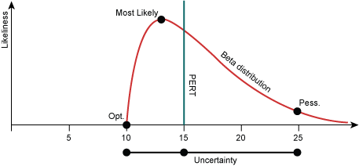
PERT calculation
Beta Distribution

Slide 100
Project Tracking

Slide 101
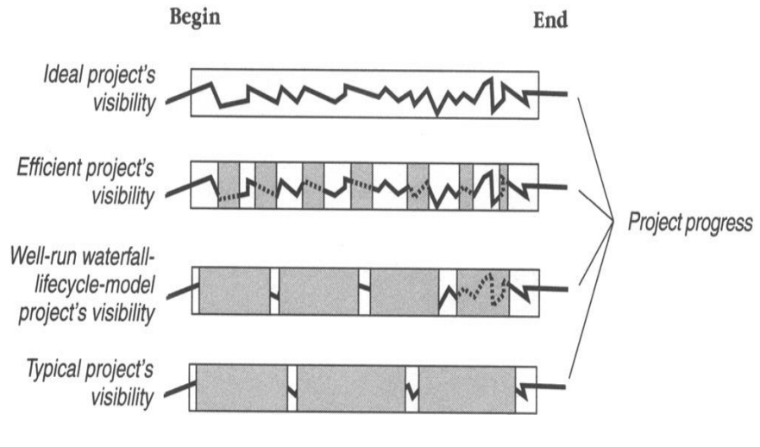
Tracking and Visibility

Slide 102
Percent Complete
Task | Complete?
Conceptual Design | Complete
Program Specification | Complete
Coding | In Progress
Documentation | In Progress
User Manual Production | Not Started
Testing | Not Started

Slide 103
Percent Complete
Task | How Complete?
Conceptual Design | 200/200
Program Specification | 300/300
Coding | 150/600
Documentation | 10/100
User Manual Production | 0/400
Testing | 0/500
660 / 2100 * 100 = 31.4% complete

Slide 104
Earned Value
Earned Value (EV) is a methodology used to control a project
It provides a uniform measure for project progress for the entire project or any sub-element
Provides a consistent method of project progress and performance
Provides a basis for cost performance analysis of a project

Slide 105
Using Earned Value Tracking
Establish a WBS to divide the project into manageable parts
Identify the activities required for the current project
Allocate the effort required for each activity
Schedule the activities over time and resources
Analyze/review the schedule

Slide 106
Using Earned Value Tracking
Update the schedule by reporting activity progress
Enter the actual cost on the activities
Execute the Earned Value calculations
Analyze the data and make course corrections as necessary

Slide 107
Earned Value
Establish a common value scale for every task, regardless of the type of work involved (software projects use effort)
Total effort for the entire project is estimated
Every task is given a planned value based on its estimated percentage of the total project effort
Completion of a task results in a credit, or an earned value, of the value allocated to the task

Slide 108
Earned Value Example
Total Project Effort: 1000 person hours
Task A Estimate: 15 person hours
Planned Value: 1.5
Completing task A contributes 1.5 to the cumulative earned value total for the project

Slide 109
Earned Value Tracking
Earned value credit is given only when the task is 100% complete
Partially completed tasks are NOT given partial credit (in most software projects)
Large tasks can/must be broken into subtasks
Size tasks up to 80 person-hours; aim for 2 to 4 task completions per week

Slide 110
Project Velocity (PV)
Σ
PV in story weeks =
Time estimated for the story
All stories completed in the iteration
Used in Agile (iterative) Development
Don’t bother to consider # of programmers or skill level. This is a rough estimation.
Project velocity tells you how many story points you can allocate to the next iteration.
The customer gets to pick stories that equal the project velocity.
Notes:
Velocity is an extremely simple, powerful method for accurately measuring the rate at which teams consistently deliver business value. To calculate velocity, simply add up the estimates of the features (user stories, requirements, backlog items, etc.) successfully delivered an iteration.
There are some simple guidelines for estimating initial velocity prior to completing the first iteration, but after that point teams should use proven, historical measures for planning features. Within a short time, velocity typically stabilizes and provides a tremendous basis for improving the accuracy and reliability of both near-term and longer-term project planning. Agile delivery cycles are very small so velocity emerges and can be validated very early in a project and then relied upon to improve project predictability.
https://www.versionone.com/agile-101/agile-management-practices/agile-scrum-velocity/

Slide 111
Project Velocity (PV)
The metric is calculated by reviewing work the team successfully completed during previous sprints; for example, if the team completed 10 stories during a two-week sprint and each story was worth 3 story points, then the team's velocity is 30 story points per sprint.
Generally, velocity remains somewhat constant during a development project, which makes it a useful metric for estimating how long it will take a team to complete a software development project.
If the product backlog has 300 story points, and the team is averaging 30 story points per sprint, it can be estimated that team members will require 10 more sprints to complete work. If each sprint lasts two weeks, then the project will last 20 more weeks.
Notes:
Velocity is an extremely simple, powerful method for accurately measuring the rate at which teams consistently deliver business value. To calculate velocity, simply add up the estimates of the features (user stories, requirements, backlog items, etc.) successfully delivered an iteration.
There are some simple guidelines for estimating initial velocity prior to completing the first iteration, but after that point teams should use proven, historical measures for planning features. Within a short time, velocity typically stabilizes and provides a tremendous basis for improving the accuracy and reliability of both near-term and longer-term project planning. Agile delivery cycles are very small so velocity emerges and can be validated very early in a project and then relied upon to improve project predictability.
https://www.versionone.com/agile-101/agile-management-practices/agile-scrum-velocity/

Slide 112
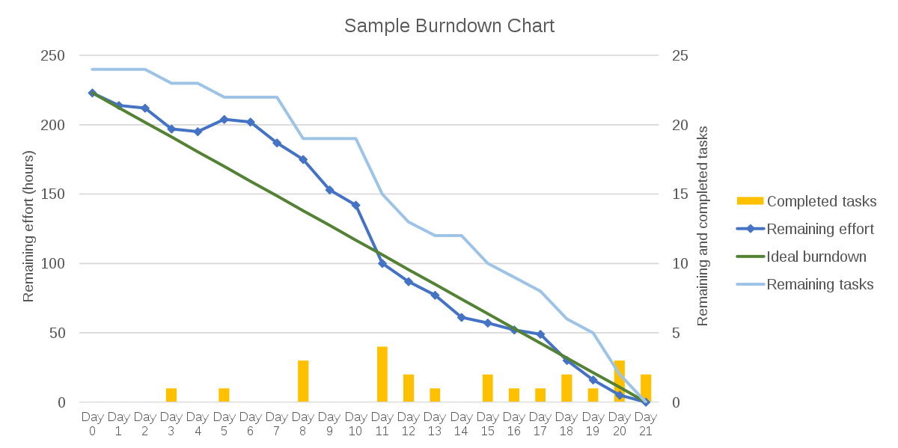
Burn down chart
A burn down chart is a visual representation of the progress of work in a project or sprint.
It is a graph that shows the amount of work remaining versus the time left to complete it.
The chart typically starts with a total amount of work to be done and a deadline, and as work is completed, the chart shows the remaining amount of work decreasing.
The goal of a burn down chart is to help project teams track progress and identify potential obstacles to completing the work on time.

Slide 113
Perform quality control
Perform quality control
a process in the project quality management knowledge area
Concerned with monitoring specific project results for compliance with quality standards
Performed throughout project
May also include taking control actions to correct causes of quality problems
Perform quality assurance
a process that provides the framework of activities and standards for performing quality control

Slide 114
Summary
Planning, Estimating, Scheduling, and Tracking are a continuum
Projects need to be partitioned for manageability
Work Breakdown Structures are a great way to do this
Sequencing Tasks & Activities is vital
Gantt Charts allow quick reference
Network Techniques such as Precedence Network Diagrams, the Critical Path Method, and PERT Charts are useful tools
Project Tracking is important for project visibility
The Earned Value Technique is a key tool in this
The project charter typically includes information such as the project's objectives, scope, timelines, budget, risks, and assumptions. It also identifies the project team members and their roles and responsibilities.

